Slide 1

FALL 2023
MIS 381N
Information management
Lecture 10
Sept 25th 2023
Prashant D. Joshi
UT McCombs School of Business (MSBA), The University of Texas at Austin

Slide 2

Objectives
Relational Databases and their issues
Relational database strengths
Relational database issues
Potential solutions
Questions and Discussion

Slide 3
What questions may I answer before we begin …
All questions are good questions

Slide 4
Housekeeping

Slide 5
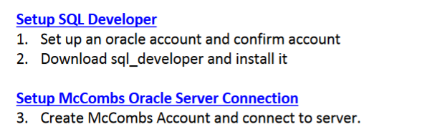
High Level Steps

Slide 6
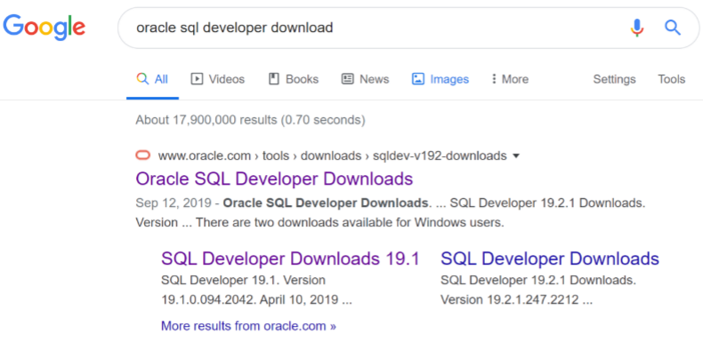
SQL Developer Setup Steps
Step 1: First go to www.oracle.com and create an account. You will find a tab at the top of screen where it reads “Sign in” and the pull down menu will allow you to choose Create Account. Step 2: Use any web browser, search for “oracle sql developer download”. Click on the first link to get to the following landing page. Click on “Accept License Agreement”. Download the the right version that matches your operating system. If you’re unsure if your PC is 32-bit or 64-bit, go to your Control Panel and double click on “System” to see what version of system you have. If you have a 64-bit system chose the 64-bit with JDK version to download. Note: Download whatever the most current version

Slide 7
Click on the first link to get to the following landing page.
Click on “Accept License Agreement”. Download the right version that matches your operating system. If you’re unsure if your PC is 32-bit or 64-bit, go to your Control Panel and double click on “System” to see what version of system you have. If you have a 64-bit system chose the 64-bit with JDK version to download.
Note: Download whatever the most current version is.
Windows: 64 bit JDK-11
Mac with Intel chip: MacOS JDK 11
Mac with ARM chip: with JDK11

Slide 8
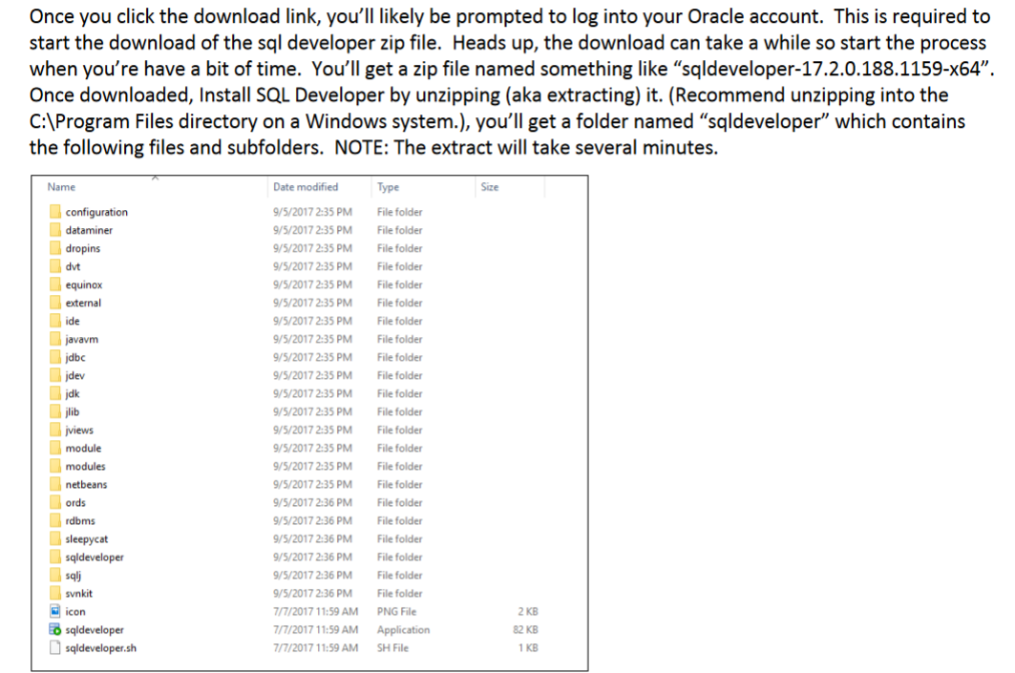

Slide 9
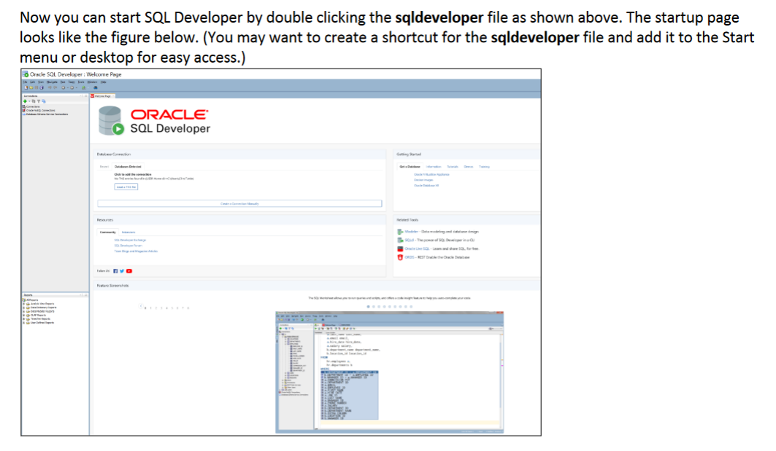

Slide 10
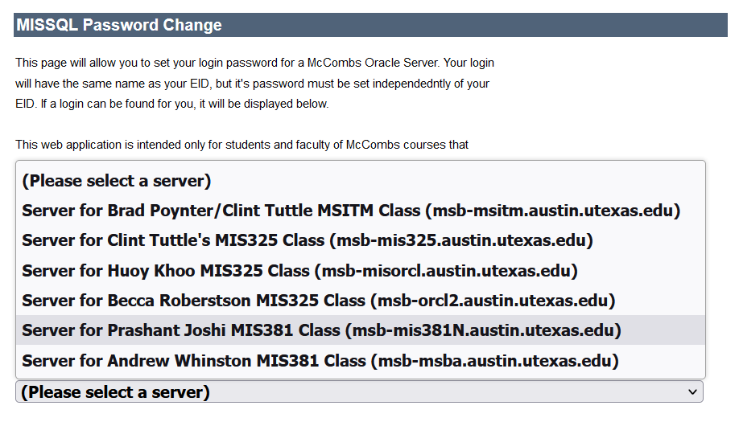
To access the server all users need to first setup their password using the SQL change password site: https://secure.mccombs.utexas.edu/MISSQLPwdChange/default.aspx . The user is to select their class from the list.
You will need that password…!!

Slide 11
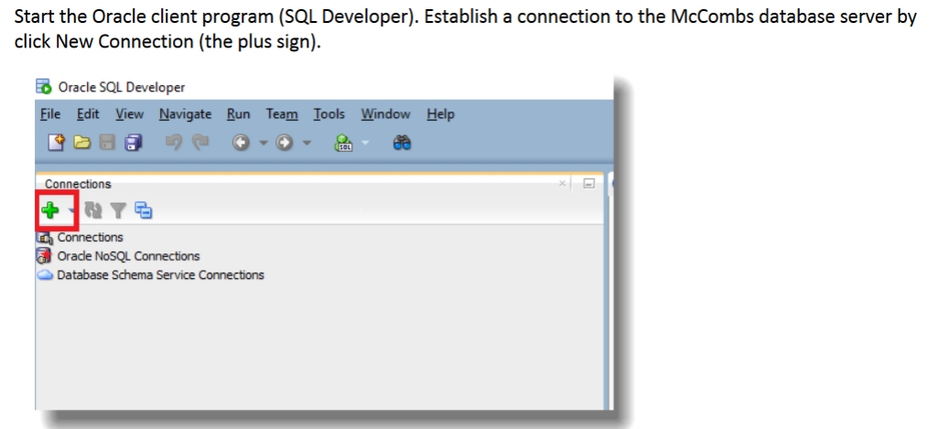

Slide 12
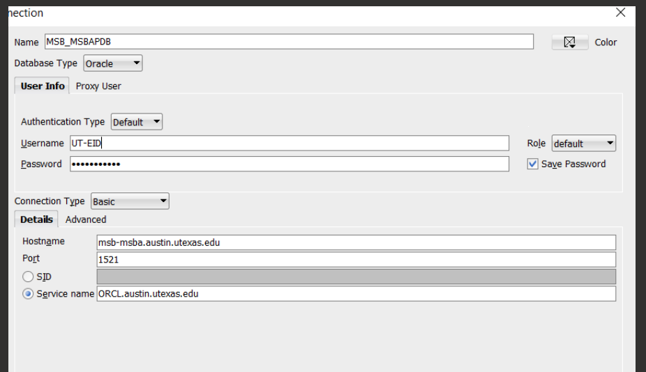

Slide 13
Review of the relational database properties

Slide 14
Relational Database features
While creating a relational database possible values and constrains are applied to the data, thus the ‘relation’
The same data can be viewed in many different ways
Based on relational calculus and relational algebra, dealing with elements such as clauses, predicates, queries and statements

Slide 15
Relational Database benefits
Some of the benefits of the database designed according to the relational model are:
Most of the information is stored in the database and not in the application, so the database is self documenting.
It is easy to add, update or delete data.
It gives benefits of data summarization, retrieval and reporting.
The database is structured in a tabular form with highly related tables; the nature of the database is predictable.

Slide 16
When to use relational databases
Here are some basic guidelines when to use relational databases:
When you have medium-level workloads, like thousands of operations per second (if you’re doing millions of transactions per second, SQL will slow you down)
Your data is structured and doesn’t change all the time
Data relationships are based on normalized data models (if you need de-normalized data models, SQL won’t fit)
You need to perform complex queries in your database (if you need simple queries only, SQL will be too much)
You use proprietary hardware to deploy the database (if you’re using cloud hosting, SQL might be too expensive?)
Source: https://dsstream.com/what-is-a-relational-database/

Slide 17
Alternatives to relational databases
NoSQL: If it is not a relational SQL, it is a NoSQL ☺
Typically, four types of NoSQL are prevalent
Key value stores: Like a hash table, limited in functionality
Graph stores: Nodes and edges with key-value pairs. If you need multiple relationships, graph stores are much better
Column stores: Transverse of the relational database. Good for statistical analysis
Document stores: Database of documents with its own schema
Source: https://dsstream.com/what-is-a-relational-database/

Slide 18
What are the strengths of relational database?

Slide 19
Relational Databases have been an incredible commercial success
Simple & Powerful Model
Standardization
High Performance & Secure
Innovation

Slide 20
Relational Databases have been an incredible commercial success
Intuitive and elegant entity-relationship model
Mathematically provable properties
Ability to represent complex, real-world business scenarios
Ability to generalize into software products and customize for specific industries and businesses
Simple & Powerful Model
Standardization
High Performance & Secure
Innovation

Slide 21
Relational Databases have been an incredible commercial success
Simple & Powerful Model
SQL is for the most part standard and portable
SQL can be used by people not interested beyond with moderate technical skills
Integration of SQL with programming languages
Robust commercial offerings (Oracle, MS-SQL, …)
Robust open-source offerings (MySQL, Postgres, …)
Standardization
High Performance & Secure
Innovation

Slide 22
Relational Databases have been an incredible commercial success
Simple & Powerful Model
Standardization
Feature rich security models (authentication, authorization, role /content based access controls, encryption, redaction, …)
Optimized physical implementations for large data volumes (partitioning, indexing, …) and thousands of concurrent users
ACID – Atomicity, Consistency, Isolation and Durability
Widely deployed business applications
High Performance & Secure
Innovation

Slide 23
Relational Databases have been an incredible commercial success
Simple & Powerful Model
Standardization
High Performance & Secure
Research by industry and academia continues
Continuous innovation for the last 40 years
Consolidation has not prevented a competitive market
Innovation

Slide 24


Relational Databases have been an incredible commercial success
Users
Simple & Powerful Model
UI/Client
Client-server architecture
Internet/Web
Cloud/SaaS
Blockchain
…
Standardization
App Servers
High Performance & Secure
Innovation
Databases

Slide 25
What are the issues with relational database?

Slide 26
However, there are several issues with Relational databases
Change Management Complexity
Business Analytics
Real-world modeling challenges
Scalability Costs

Slide 27
However, there are several issues with Relational databases
Changing the data model is difficult, time-consuming and expensive
Maintenance of database code such as stored procedures is difficult
Diagnosing performance changes in a database is complex
Maintaining user roles and privileges is manual and challenging
Change Management Complexity
Business Analytics
Real-world modeling challenges
Scalability Costs

Slide 28
However, there are several issues with Relational databases
Change Management Complexity
Data needed for analytics is distributed across multiple databases
Often data from these multiple databases cannot be combined easily
Lack of uniform naming standards or definitions of data across multiple databases
Many advanced analytical tools are not integrated well with the DBMS
Business Analytics
Real-world modeling challenges
Scalability Costs

Slide 29
However, there are several issues with Relational databases
Change Management Complexity
Business Analytics
Limited data types – an issue for text, video, audio, location data
Entities artificially separate “data” from “behavior”
Real-world scenarios such as graphs and inheritance difficult to model
Difficult to represent “semantics” of relationships
Difficult to deal with “streaming” data
Real-world modeling challenges
Scalability Costs

Slide 30
However, there are several issues with Relational databases
Change Management Complexity
Business Analytics
Real-world modeling challenges
Commercial products are expensive with increasing annual costs
Highly skilled labor required for maintenance
Expensive hardware infrastructure for high performance
Scalability Costs

Slide 31
What are potential solutions to the issues with relational database?

Slide 32
Potential Solutions to issues
Change Management Complexity
NoSQL, Schema less databases
Key-value pairs
Business Analytics
Data warehousing
Relational Online Analytical Processing
Object oriented databases, Active databases
Semantic databases
Text and multimedia databases
Real-world modeling challenges
Scalability Costs
Cloud computing

Slide 33
Specialized solutions have been developed over the years to address the limitations of relational database management systems

Slide 34

Course Lookahead
Data Warehousing, ETL, OLAP)
Mid-term exam
Start thinking of Projects
Data Architecture (Case discussion)
Data Governance(Case discussion)
Big Data/MapReduce
Spark
Project Discussion
Project Presentations

Slide 35
What questions may I answer before we conclude …
All questions are good questions

Slide 36
Appendix

Slide 37
Difference between Relational Algebra and Relational Calculus
 | Basis of Comparison | Relational Algebra | Relational Calculus
1. | Language Type | It is a Procedural language. | Relational Calculus is a Declarative (non-procedural) language.
2. | Procedure | Relational Algebra means how to obtain the result. | Relational Calculus means what result we have to obtain.
3. | Order | In Relational Algebra, the order is specified in which the operations have to be performed. | In Relational Calculus, the order is not specified.
4. | Domain | Relational Algebra is independent of the domain. | Relation Calculus can be domain-dependent because of domain relational calculus.
5. | Programming language | Relational Algebra is nearer to a programming language. | Relational Calculus is not nearer to programming language but to natural language.
6. | Inclusion in SQL | The SQL includes only some features from the relational algebra. | SQL is based to a greater extent on the tuple relational calculus.

Slide 38
Difference between Relational Algebra and Relational Calculus
S.NO | Basis of Comparison | Relational Algebra | Relational Calculus
7. | Relationally completeness | Relational Algebra is one of the languages in which queries can be expressed but the queries should also be expressed in relational calculus to be relationally complete. | For a database language to be relationally complete, the query written in it must be expressible in relational calculus.
8. | Query Evaluation | The evaluation of the query relies on the order specification in which the operations must be performed. | The order of operations does not matter in relational calculus for the evaluation of queries.
9. | Database access | For accessing the database, relational algebra provides a solution in terms of what is required and how to get that information by following a step-by-step description. | For accessing the database, relational calculus provides a solution in terms as simple as what is required and lets the system find the solution for that.
10. | Expressiveness | The expressiveness of any given language is judged using relational algebra operations as a standard. | The completeness of a language is measured in the manner that it is least as powerful as calculus. That implies relation defined using some expression of the calculus is also definable by some other expression, the language is in question.

